Slide 1
Topics of Discussion:
CEPA Overview
Determining Environmental Significance
Step-by-step CEPA Process
Additional Resources
CEPA and NEPA
Questions
Connecticut Environmental Policy Act (CEPA) Training
Prepared by the Office of Policy and Management (OPM) 10/06/2021

Slide 2
Statutory & Regulatory References
  Connecticut General Statutes (CGS) Sections 22a-1 through 22a-1h, established in 1973 (PA 73-562), and revised in 2002 (PA 02-121):
  Sections 22a-la-1 through 22a-la-12 Regulations of Connecticut State Agencies (RCSA), established in 1978, and revised in 2019:
Notes:
Note that new Regulations adopted in 2019.

Slide 3
Identify potential environmental impacts including social and economic impacts;
Assess potential alternatives;
Provide opportunity for public review and comment;
Document the agency’s review and decision.
Why CEPA?
After establishing a clear purpose and need for why the state action is needed, CEPA is the vehicle for assessing how the action will be implemented.
Notes:
Sec 22a-1a-1 of the RCSA definition of “Environment” means the physical, biological, social, and economic surroundings and conditions....
CEPA assists in evaluating alternatives and determining the best approach to satisfying the underlying purpose and need.

Slide 4










CEPA applies to any state agency, department, or institution undertaking an action which may affect the environment.
Who must comply with CEPA?
Notes:
In NEPA terms, the state agency, department, or institution is the “responsible entity”. Cannot be delegated.
Quasi-public agencies are not a “state agency, department, or institution”, unless in partnership with, or funded by, a state agency. Contact OPM.

Slide 5
What is an action under CEPA?
“Action” means an individual activity or a sequence of planned activities initiated or proposed to be undertaken by an agency or agencies, or funded in whole or in part by the state .....
(Sec. 22a-1a-1 RCSA)
Notes:
Key takeaway: ACTION = agency is proposing the project or funded by the state.
Multi-phase projects must be evaluated for potential impacts from all anticipated phases.
A lot of things agencies do qualify as actions, but many will not require scoping.

Slide 6
“Actions” include, but are not limited to:
capital improvements, alterations, or additions to the real property of the state;
acquisition of real property for the purpose of capital improvements;
lease/purchase agreements;
grants-in-aid or financial assistance for housing, business, industry, restoration or demonstration projects; or
other proposed activity for which an agency exercises judgment or discretion as to the propriety of that action. (RCSA 22a-1a-1 RCSA)
What is an action under CEPA?
Notes:
CEPA “Actions” are generally synonymous with “choice limiting actions” under NEPA. Except for the disposal or transfer of property which have their won processes.
Generally not considered to be an “action” under CEPA (ie. exempt from CEPA): planning, design, minor maintenance and repair, emergency, and ministerial, etc

Slide 7
Actions which may significantly affect the environment. means individual activities or a sequence of planned activities proposed to be undertaken by state departments, institutions or agencies, or funded in whole or in part by the state, which could have a major impact on the state's land, water, air, historic structures and landmarks as defined in section 10-410, existing housing, or other environmental resources, or could serve short term to the disadvantage of long term environmental goals. Such actions shall include but not be limited to new projects and programs of state agencies and new projects supported by state contracts and grants, but shall not include (1) emergency measures undertaken in response to an immediate threat to public health or safety; or (2) activities in which state agency participation is ministerial in nature, involving no exercise of discretion on the part of the state department, institution or agency. (CGS 22a-1c)
What is an action under CEPA?
Notes:
Adds detail to definition of “action”, which could have a major impact on...
Shall not include shall not include (1) emergency measures or (2) ministerial actions that involve no exercise of discretion by the state agency
There is a difference between an “action” and “actions which may significantly affect the environment”

Slide 8
Agency initiates an “Action”
Scoping
Agency provides for public notice of basic project information and initiates a minimum 30-day public comment period.
Post-Scoping
Agency provides for public notice summarizing public comments received and the agency’s responses, and indicating whether or not the agency will be preparing an EIE.
EIE
Agency provides for publication of the EIE and initiates a minimum 45-day comment period.
ROD
Agency shall review and address all EIE comments received and prepare a record of decision indicating the agency’s decision whether to proceed with the action.
CEPA Process Overview
OPM reviews the EIE and ROD for adequacy
Notes:
Not all projects will go through this entire process.

Slide 9

Agency initiates an “Action”.
No CEPA required. This concludes the agency’s CEPA responsibilities.
Is the project an “action”?
If “no”
Initiating a CEPA Review
Is the project an “action which may significantly affect the environment”?
In making this determination, the agency shall consider:
The Environmental Classification Document (ECD);
The factors in 22a-1a-3 of the RCSA;
Any known public comments/controversy;
Inconclusive or unknown impacts.
The agency shall internally document its decision. (OPM provides a checklist to assist with this). This concludes the agency’s CEPA responsibilities.
If “no”
Determining Environmental Significance
Notes:
Generally not considered to be an “action” under CEPA (ie. exempt from CEPA): planning, design, minor maintenance and repair, emergency, and ministerial, etc
Generic ECD: the thresholds are intended to be benchmark for projects and impacts not specifically captured by the ECD.
Environmental Review Checklist (ERC) is a tool to assist in evaluating and documenting an agency’s review.

Slide 10
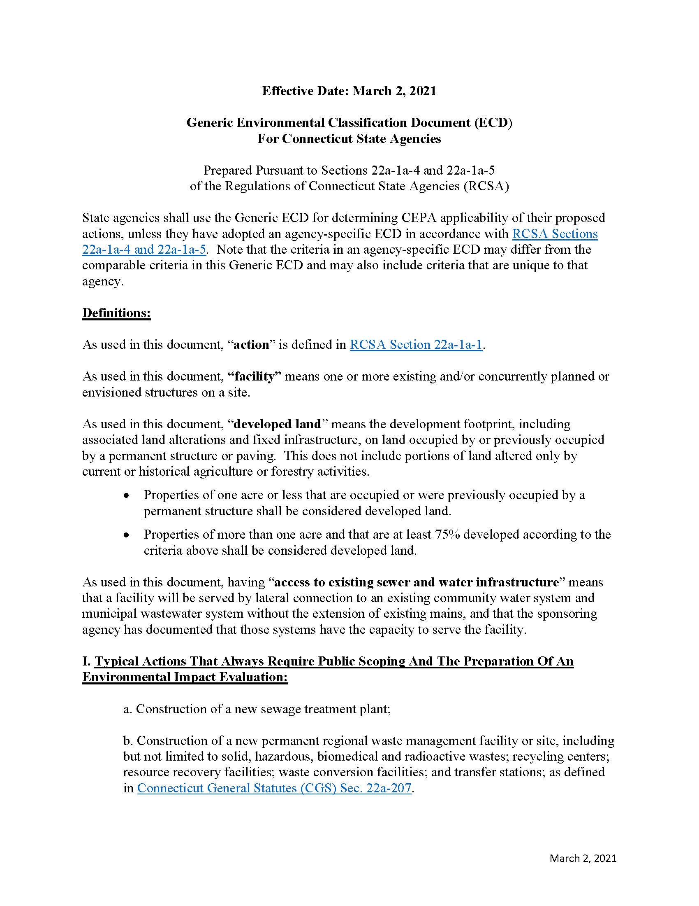
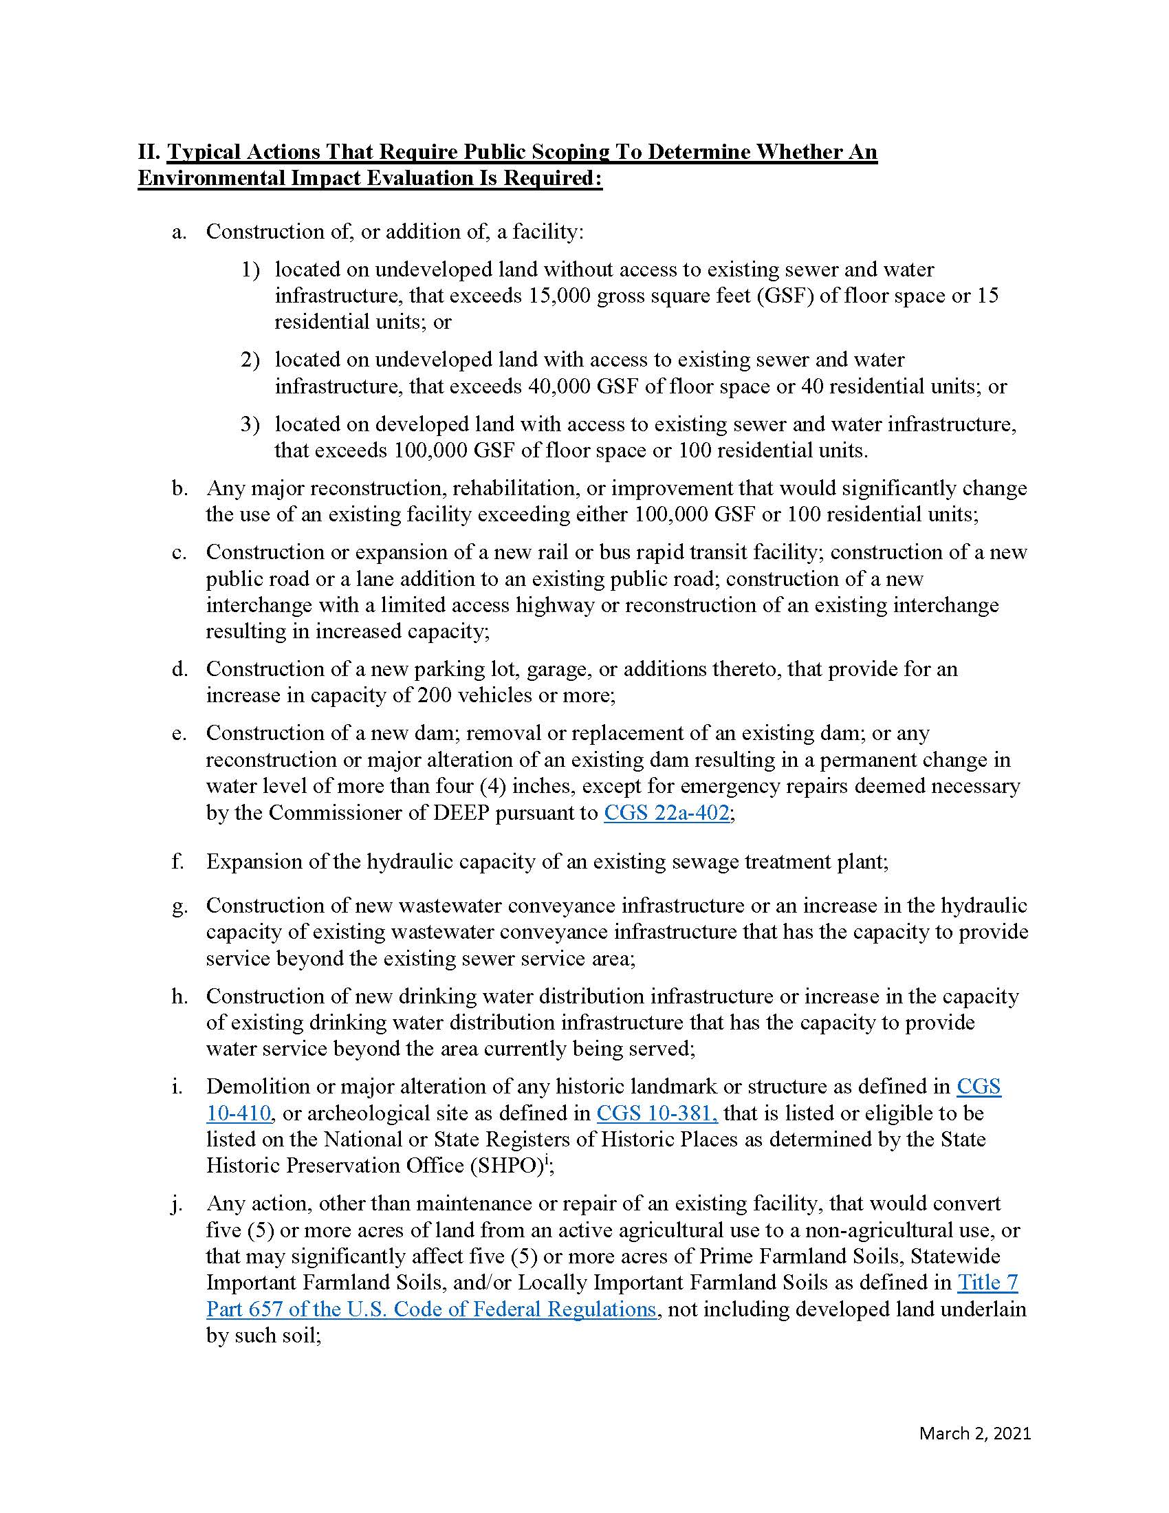
Generic Environmental Classification Document (ECD) https://portal.ct.gov/-/media/OPM/IGP/ORG/CEPA/Revised-Generic-ECD_03022021.pdf
The ECD is a list of typical agency actions that may have significant environmental impacts and is a tool to assist agencies in determining if a proposed action warrants further CEPA evaluation.
It is often the first step in determining an action’s environmental significance.
Notes:
ECD is broken out into four sections, most of which contain thresholds that dictate the level of review required by CEPA.
Only DOT has its own ECD.

Slide 11
Factors identified in 22a-1a-3 of the RCSA
Requires consideration of the direct, indirect, and cumulative effects of the factors listed:
https://eregulations.ct.gov/eRegsPortal/Browse/RCSA/Title_22aSubtitle_22a-1aSection_22a-1a-3/
Direct effects are the primary environmental consequences;
Indirect effects are the secondary consequences ... which could result from additional activities induced or stimulated by the action; and
Cumulative effects are the effects on the environment which result from the incremental impact of the action when considered with past, present or reasonably foreseeable future actions to be undertaken by the sponsoring or participating agencies.
Notes:
Identifying an impact does not necessarily mean the project is an “action which may significantly affect the environment”.
Cumulative effects are compounded by related past, present, or future actions. Chain reaction of impacts.

Slide 12
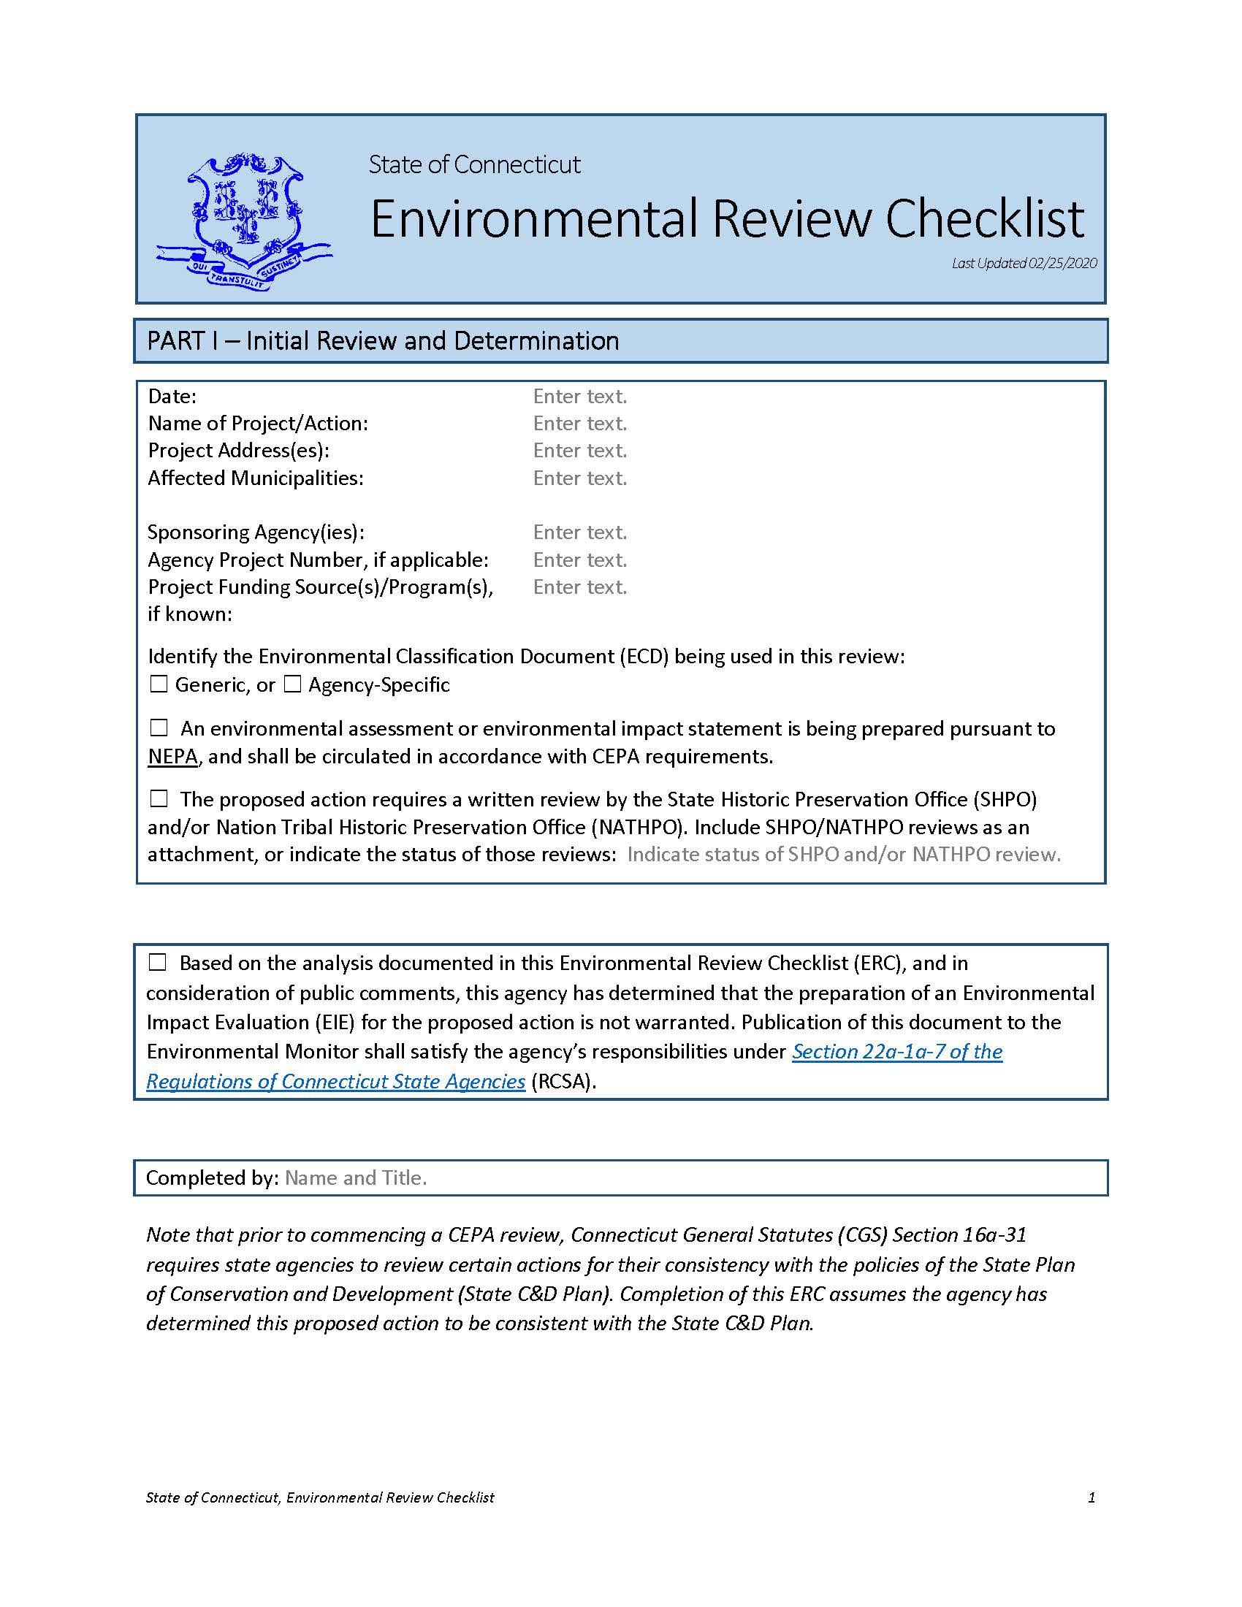
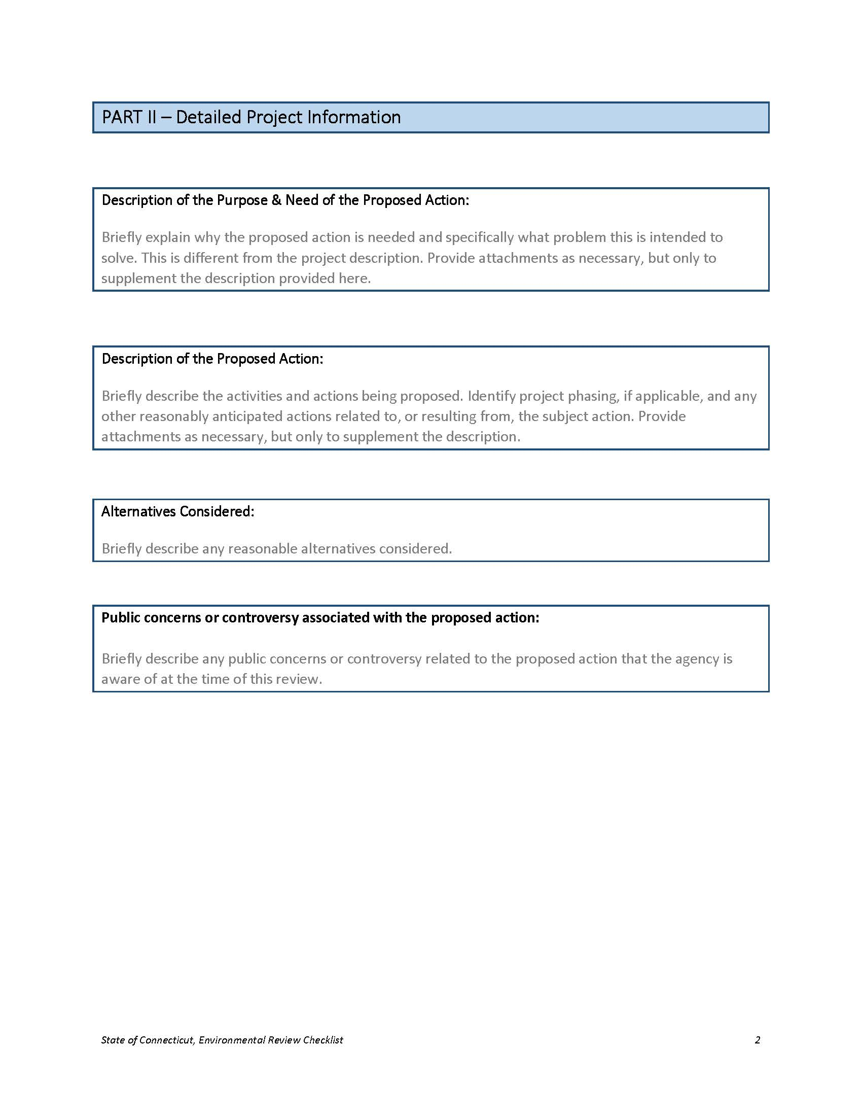
Environmental Review Checklist (ERC) https://portal.ct.gov/-/media/OPM/IGP/ORG/CEPA/Environmental-Review-ChecklistBlank-Fillable02252020.docx
Used to assist agencies in determining whether an action requires Scoping, and to record an agency’s initial assessment of the potential environmental effects of a proposed action.
A sponsoring agency is required to publish its completed ERC whenever it publishes a post-scoping notice indicating that an EIE will not be prepared.
Notes:
An agency may use the ERC to internally document its decision not to scope an action.
An ERC is required as part of post-scoping notice when an EIE is not required.

Slide 13
The purpose of scoping is to notify the public and provide opportunity for public comment. (Section 22a-1a-6 of the RCSA)
Agency provides publication in the Environmental Monitor for a minimum of 30-days to accept public comments, and may hold a public informational meeting or be required to do so.
Scoping notice shall include enough project detail to provide for adequate public consideration and comment.
Scoping
Projects that undertake scoping MUST culminate with a post-scoping notice.
Up Next: Post-Scoping

Slide 14
The main purpose of the post scoping notice is to publicly indicate whether or not an agency will be conducting an EIE.
After completing scoping, the agency shall consult with all state agencies and municipalities that submitted substantive comments.
The agency shall publish a post-scoping notice to indicate whether or not the agency will be conducting an EIE.
Agencies must publish project updates every six (6) months until the post-scoping notice can be published.
Post Scoping
If no EIE, then the agency shall also publish a completed Environmental Review Checklist (ERC) with the notice. Publication of the notice concludes the agency’s CEPA responsibilities.
If an EIE will be prepared, then the agency shall begin preparing an EIE.
Up Next: EIE
Notes:
Required to consult with agencies and municipalities per the Regs.
See Sec. 22a-1a-7. of the RCSA for more details regarding what is to be included in post-scoping notice.
Project update notifies the public that the project is still viable.

Slide 15
An Environmental Impact Evaluation is a more detailed evaluation of a proposed action, its potential impacts, and reasonable alternatives.
After conducting scoping, the sponsoring agency shall prepare an EIE if:
  (1) required by Section I the ECD, or
  (2) the agency determines that significant environmental impacts exist.
After preparing the EIE, the agency provides publication in the Environmental Monitor for a minimum of 45-days to accept public comments, and may hold a public informational meeting or be require to do so.
Environmental Impact Evaluation (EIE)
Upon conclusion of the comment period, the sponsoring agency shall review comments received, prepare responses, and if necessary, conduct further analysis or amend the EIE.
Up Next: ROD
Notes:
Even if you know an EIE will be necessary, you must complete the scoping and post-scoping steps in order.
Section I of the ECD: Construction of (1) a new sewage treatment plant, or (2) a permanent regional wastewater facility.
An EIE can be used to specifically address issues identified in the earlier analysis.

Slide 16
The ROD is the agency’s determination whether or not to proceed with the proposed action. (Section 22a-1a-10 of the RCSA)
The agency shall develop an ROD containing all of the criteria identified in the regulations, and submit the ROD and EIE to OPM for its determination of adequacy. ROD shall also be published to the Environmental Monitor.
OPM reviews the EIE and ROD to determine adequacy.
If determined adequate by OPM the agency may proceed with proposed action. This concludes the agency’s CEPA responsibilities.
If determined inadequate, OPM shall specify the areas of inadequacy and the corrective action required. The agency may revise and resubmit.
Record of Decision (ROD)
OPM must publish its determination of adequacy in the Environmental Monitor.
Notes:
An agency may cancel a project at any time during the CEPA process. Public notification is required. Contact OPM for details.

Slide 17
OPM maintains a webpage with useful information and additional resources, including more in-depth training material:
https://portal.ct.gov/OPM/IGPP-MAIN/Responsible-Growth/CEPA/Overview-of-Connecticut-Environmental-Policy-Act
OPM Inventory of State Agency Actions: ftp://ftp.ct.gov/opm/CEPA/CEPA%20Project%20Inventory.xlsx
Environmental Monitor Templates:
https://portal.ct.gov/-/media/CEQ/Env-Monitor-Notices-in-Word/Sitecore-training-slides-Env-Monitor-Notices-2-6-2020.pdf?la=en&hash=89BEA2886351BDAAC1B45B01C560ED45
Additional Resources

Slide 18
Separate, yet related, requirements;
Satisfying one does not automatically satisfy the other;
CEPA only applies for actions undertaken by a state agency or funded in whole or in part by an agency;
NEPA documents may be used to satisfy CEPA requirements provided that the NEPA documents meet, and are circulated in accordance with, the CEPA document-equivalent requirements and provided that such NEPA analysis, documents, and public processes meet the CEPA equivalent requirements (see Section III of the Generic ECD).
CEPA and NEPA

Slide 19
Contact Information:
Matthew Pafford, Office of Policy and Management,
  Matthew.pafford@ct.gov Phone: 860.418.6412
Bruce Wittchen, Office of Policy and Management,
  Bruce.Wittchen@ct.gov Phone: 860.418.6323
Questions

